Slide 1

AI and the Environment 6:
Unsupervised K-Means Clustering

Slide 2
Unsupervised Learning
Unsupervised learning means that you do not have any labelled training data you simply feed it the raw data.
The algorithm then finds patterns in this data and categories each row of data into one of these categories.
There are many different methods of unsupervised learning:

Slide 3
Unsupervised Learning
There are many different methods of unsupervised learning:
K-means
Unsupervised Decision trees
Restricted Bachman Machines – Unsupervised Neural networks!

Slide 4
Unsupervised Learning
There are many different methods of unsupervised learning:
K - means
Unsupervised Decision trees
Restricted Bachman Machines – Unsupervised Neural networks!

Slide 5
K Means
K Nearest neighbour is the simplest unsupervised clustering algorithm.
KNN can be used for supervised classification as well but with unsupervised is referred to as K-means
It is a very simple algorithm that finds clusters by taking a measure of distance of a data point from the mean of a group.
It has 2 major hyperparameters that you should specify before hand: the number of clusters and the number of times to run through the data.

Slide 6
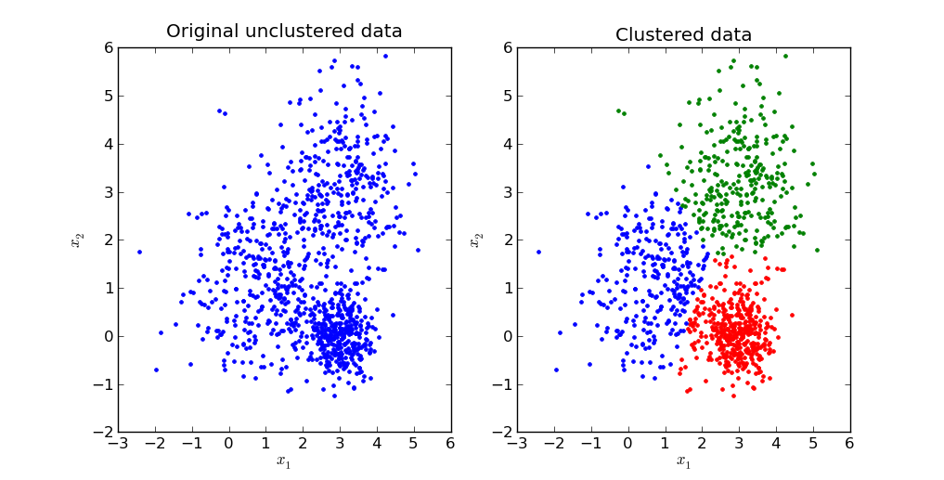
K Means

Slide 7
K Means
It has a very simple series of steps to work:
Step 1: Pick K random starting points within the parameter space.
Step 2: measure the distance of each point from all the clusters and assign each point to the closest cluster.
Step 3: Take the mean of each cluster and make that the new starting point of the cluster.
Step 4: Repeat step 2 and 3 until you have reached max iterations or clusters have stopped moving.

Slide 8
K Means
Step 1: Pick K random starting points within the parameter space.
Step 2: measure the distance of each point from all the clusters and assign each point to the closest cluster.
Step 3: Take the mean of each cluster and make that the new starting point of the cluster.
Step 4: Repeat step 2 and 3 until you have reached max iterations or clusters have stopped moving.

Slide 9
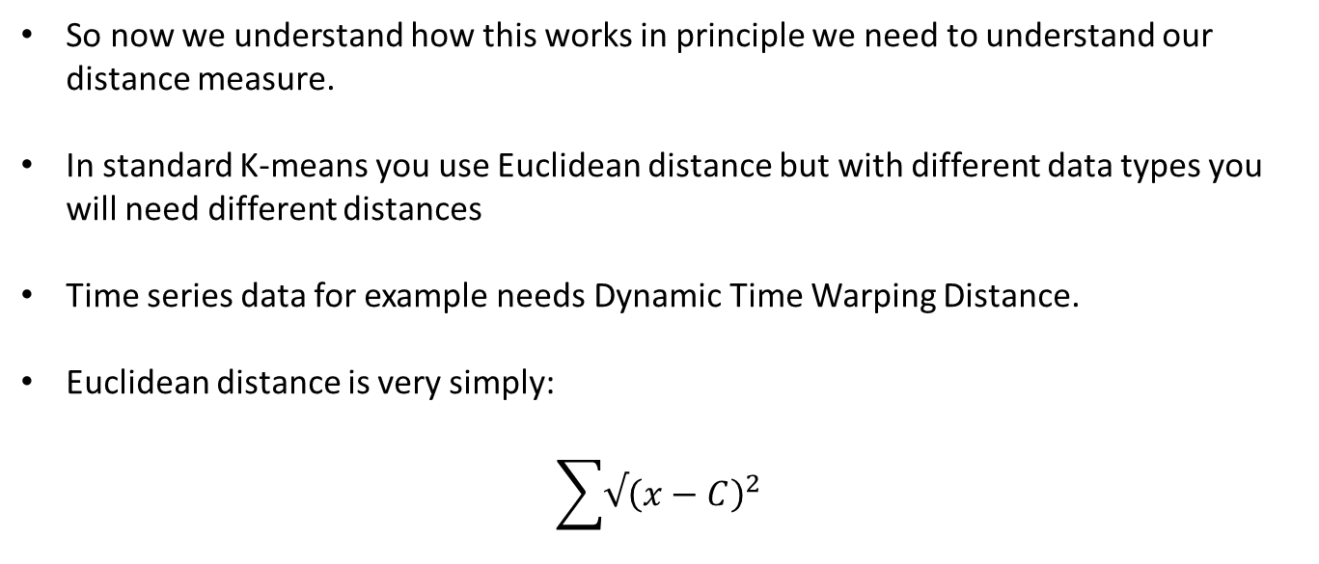
Euclidean Distance
So now we understand how this works in principle we need to understand our distance measure.
In standard K-means you use Euclidean distance but with different data types you will need different distances
Time series data for example needs Dynamic Time Warping Distance.
Euclidean distance is very simply:
$$\sum{√{\left(x−C\right)}^{2} }$$

Slide 10
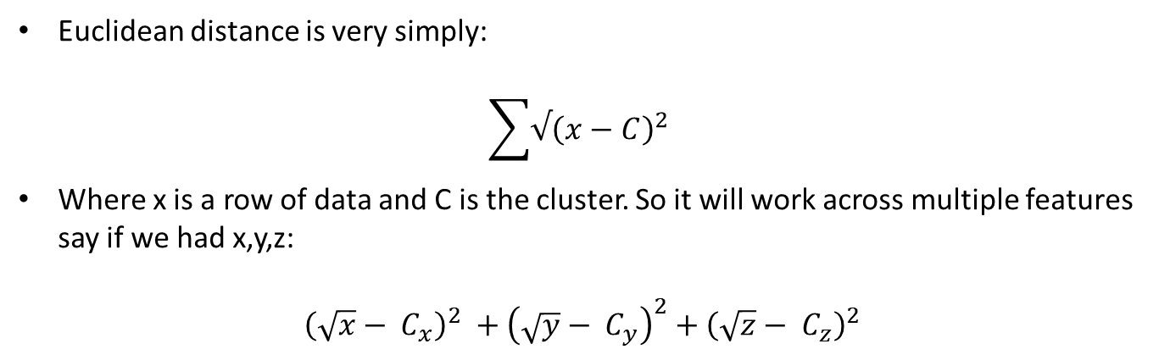
Euclidean Distance
Euclidean distance is very simply:
$$\sum{√{\left(x−C\right)}^{2} }$$
Where x is a row of data and C is the cluster. So it will work across multiple features say if we had x,y,z:
$${\left(\sqrt{x}− C_{x}\right)}^{2} +{\left(\sqrt{y}− C_{y}\right)}^{2}+{\left(\sqrt{z}− C_{z}\right)}^{2}$$

Slide 11
K Means
K-means really is that simple
The only last point is choosing your value of K.
Often you will know or have an idea of K, say you want the 5 most common of something you set K to 5
If you don’t know you can use the elbow approach

Slide 12
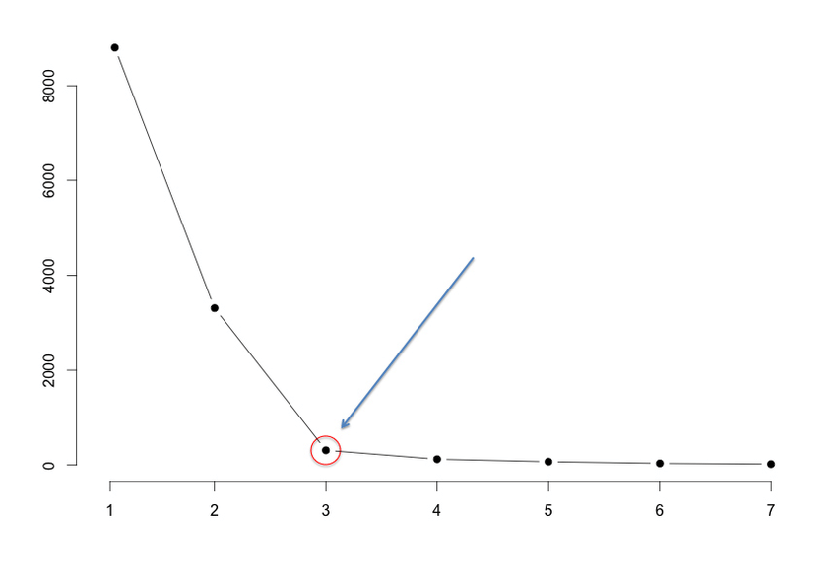
K Means
If you don’t know you can use the elbow approach.
Run the algorithm across a variety of Ks (in this case 1:7) and choose the point where you stop getting large decreases in sum of squared errors.
Elbow point

